Slide 1

Final Year Project - II
BLoved-Bidding
Supervisor Name: Ms Ayesha Majid
Student Name: Muhammad Nasir Sap ID: 25924

Slide 2
Introduction
Bloved Bidding is an online marketplace for buying and selling pre-loved items. Built with the MERN stack, it allows buyers to browse products, join live auctions, and buy items directly. Sellers can create products, Create auctions, manage orders, and create promotions. Admins oversee users, products, and transactions. The platform ensures fair bidding, secure transactions, and a smooth user experience. With features like messaging, reviews, and event creation, Bloved Bidding offers a trusted and competitive alternative for online buying and selling.

Slide 3
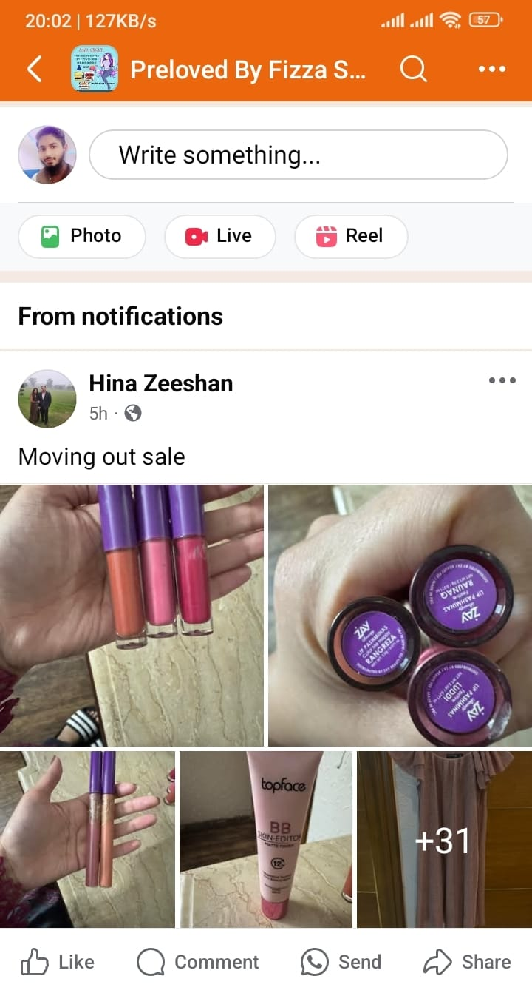
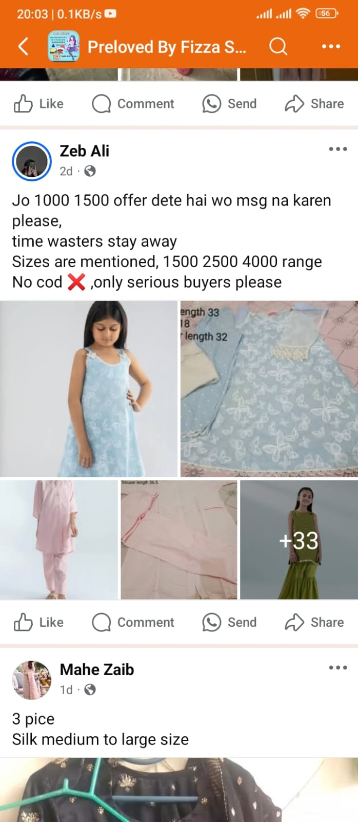
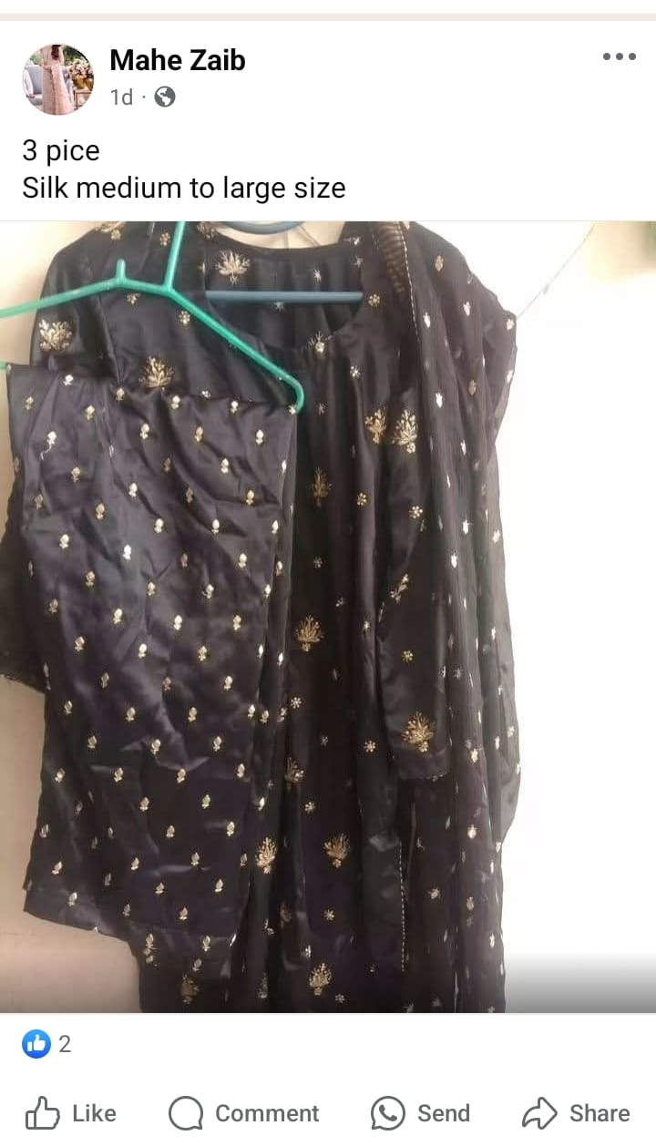
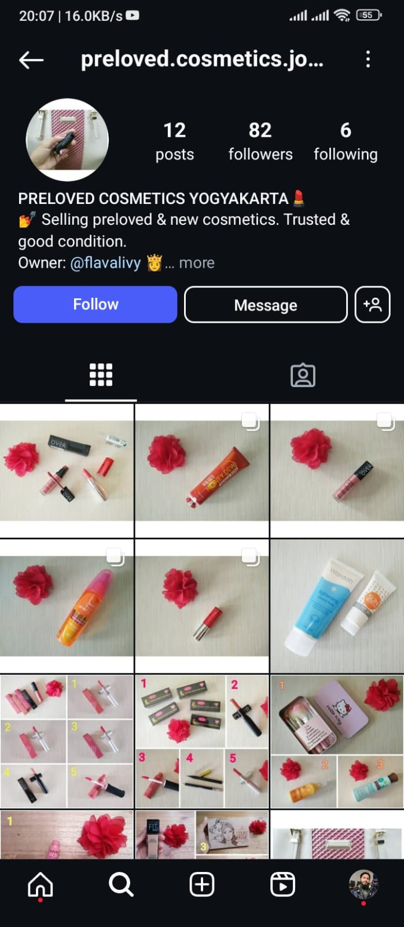
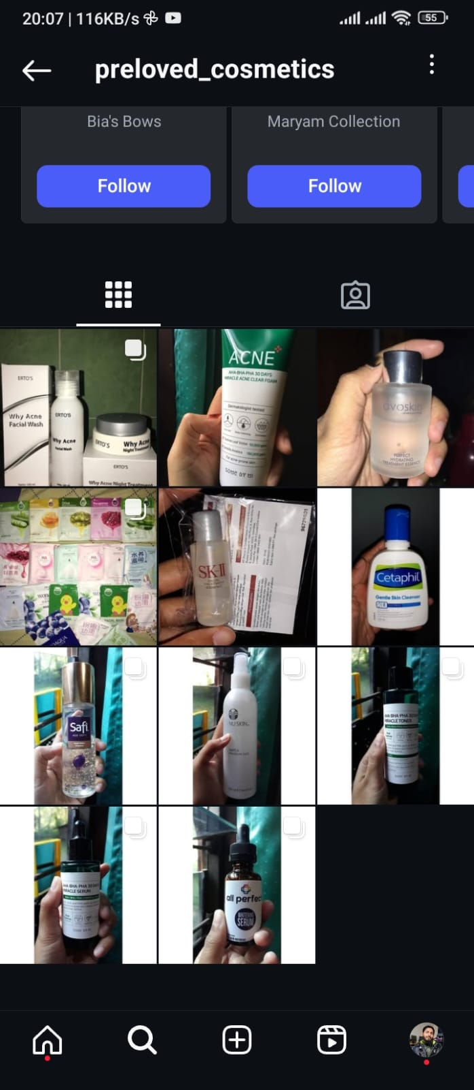
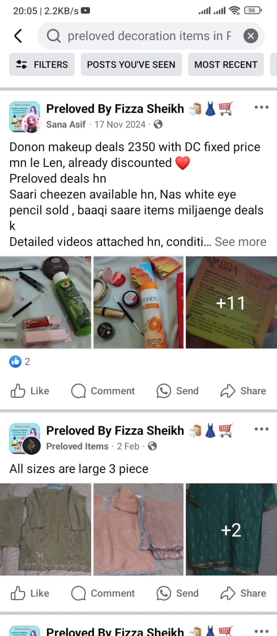
Problem Statement
Unused items go to waste because there is no proper platform to resell them easily.
Existing marketplaces lack competitive bidding, making it hard for sellers to get the best price.
Buyers struggle to find affordable second-hand items with a transparent bidding system.
Facebook and Instagram pages exist for buying and selling, but no dedicated platform provides a proper bidding system with structured transactions.

Slide 4
Solution
Structured Bidding System: Allows sellers to auction pre-loved items, ensuring competitive pricing.
Direct Buy Option: Buyers can purchase products instantly without participating in the auction.
Seller Dashboard: Helps sellers manage orders, products, bids, events, and promotions easily.
Buyer Convenience: Users can browse, bid, buy, and communicate with sellers efficiently.

Slide 5
Solution
Review & Rating System: Ensures product quality and builds trust between buyers and sellers.
Seamless Communication: Integrated messaging system for direct interaction between buyers and sellers.
Dedicated Marketplace: Unlike Facebook or Instagram pages, Bloved Bidding provides a proper platform for structured resale and biddings.

Slide 6

Features
User Authentication
Bidding System
Cart / Check Out
Wishlist
Product Management
Event Creation
Order Management
Review & Rating
Shop Customization
Live Auction
Chat

Slide 7

Functional Requirement
User Authentication & Authorization
Product Management
Bidding System
Order Management
Review & Rating System
Wishlist Feature
Event & Coupon Creation
Payment Processing

Slide 8

Non-Functional Requirement
Performance
Security
Scalability
Usability
Availability
Data Integrity

Slide 9
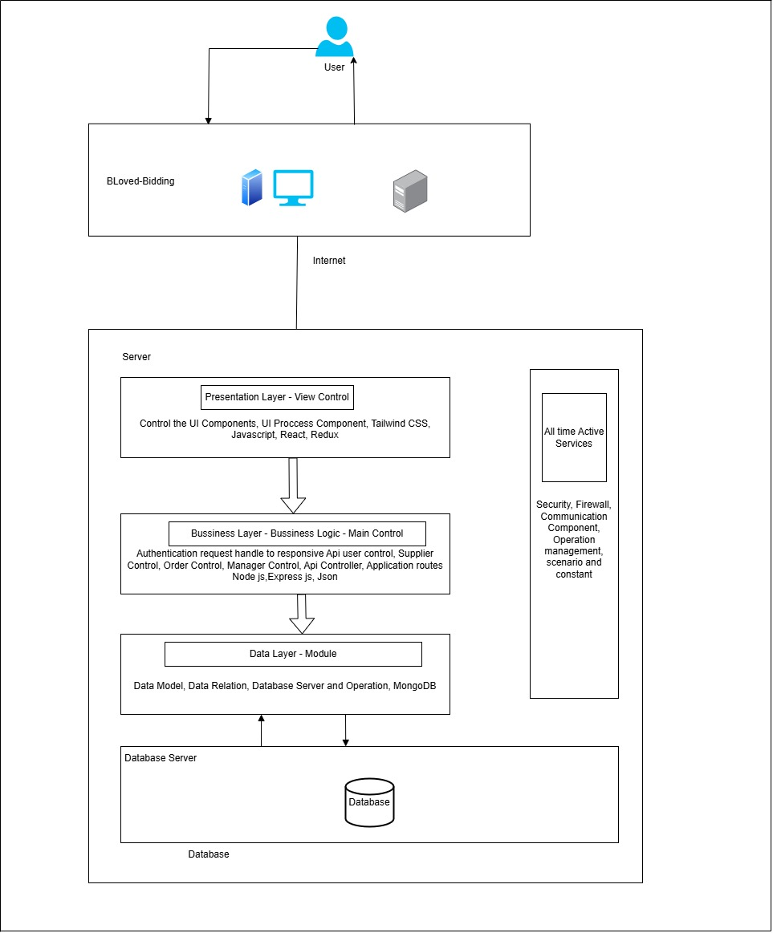
Architecture Diagram

Slide 10
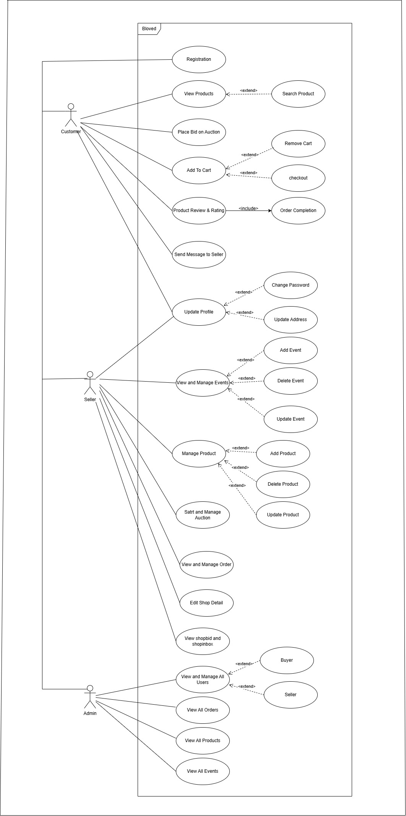
Usecase Diagram

Slide 11
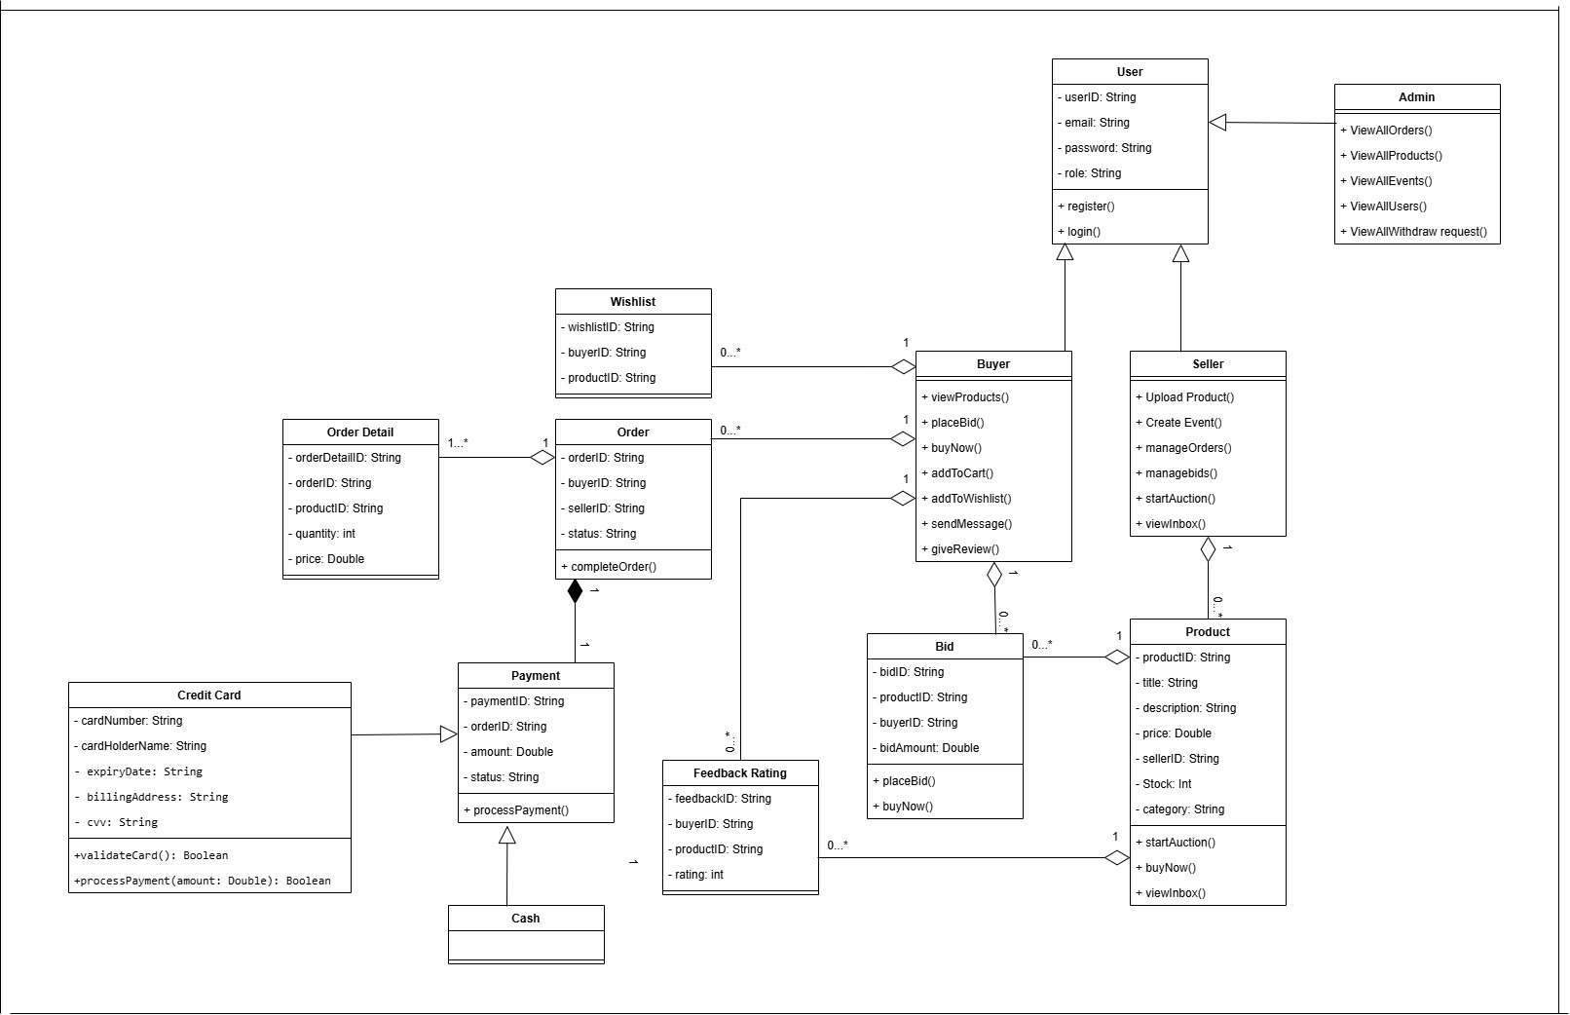
Class Diagram

Slide 12
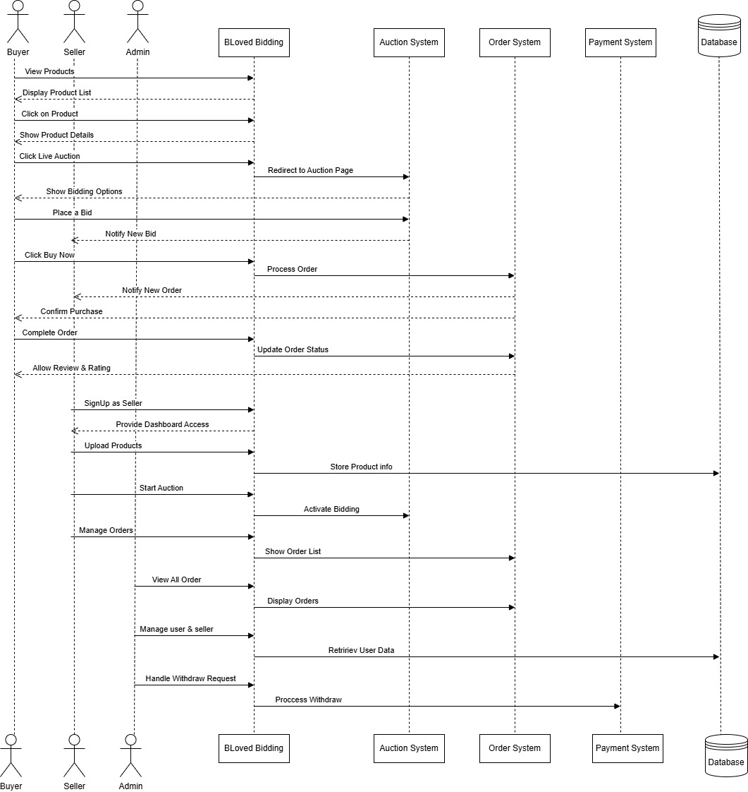
Sequence Diagram

Slide 13
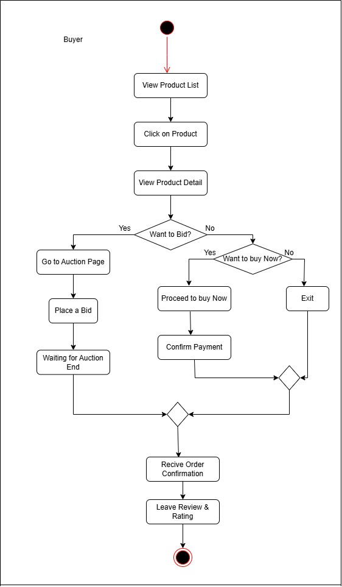
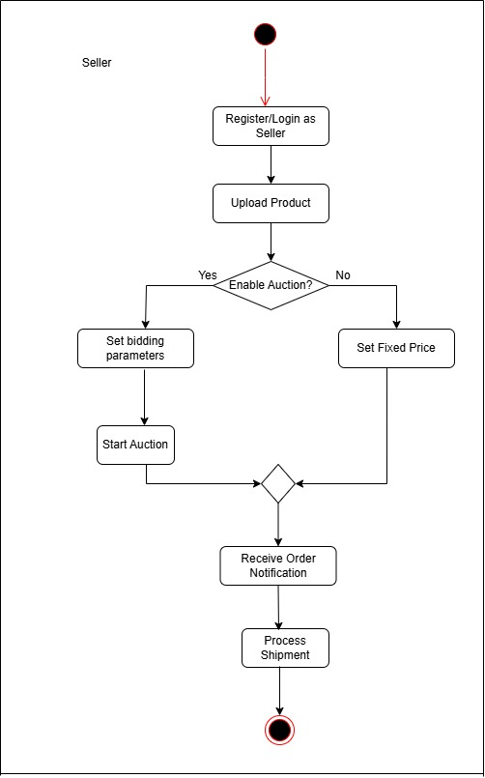
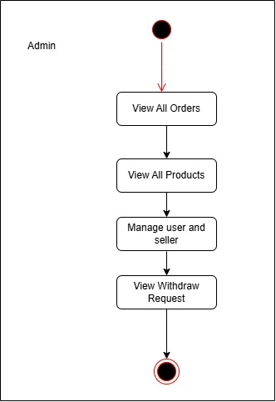
Activity Diagram
Activity Diagram

Slide 14
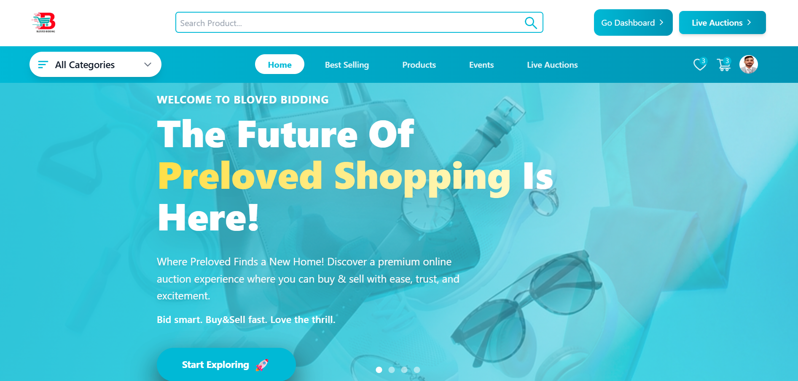
Home Page Hero Section

Slide 15
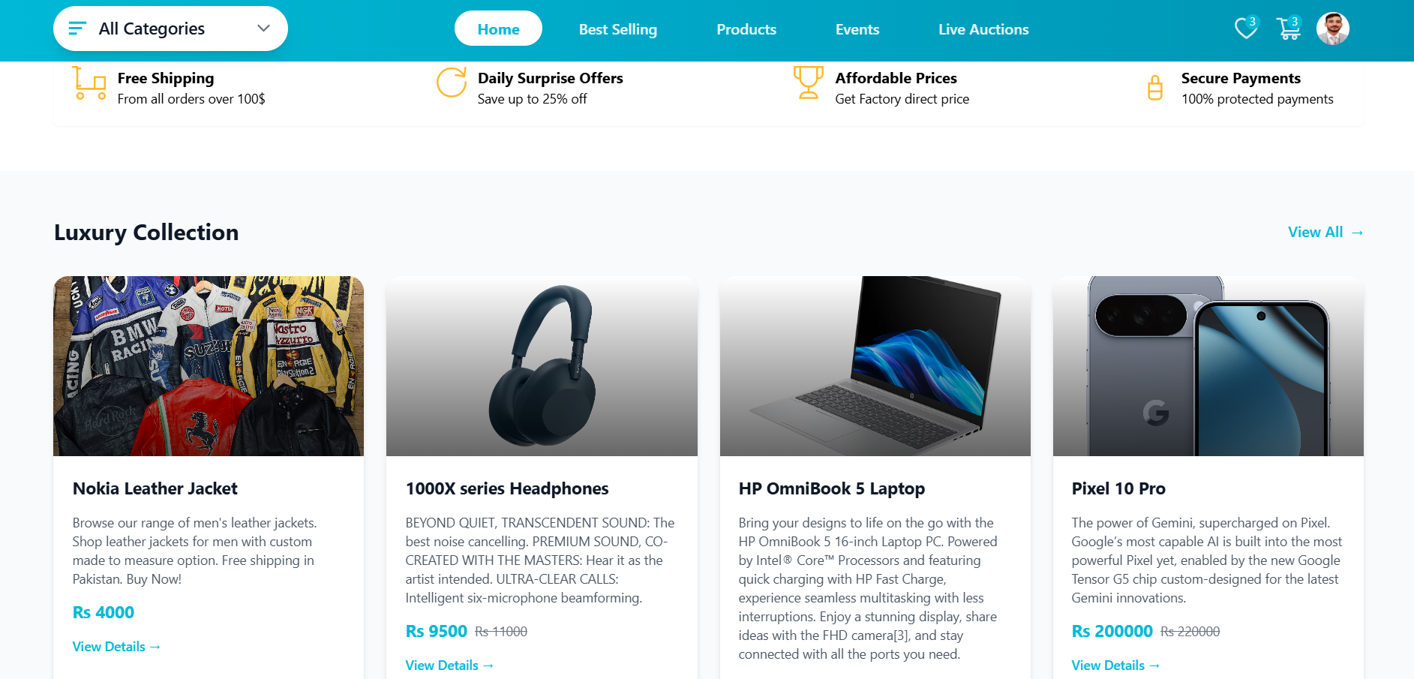
Home Page Category Section

Slide 16
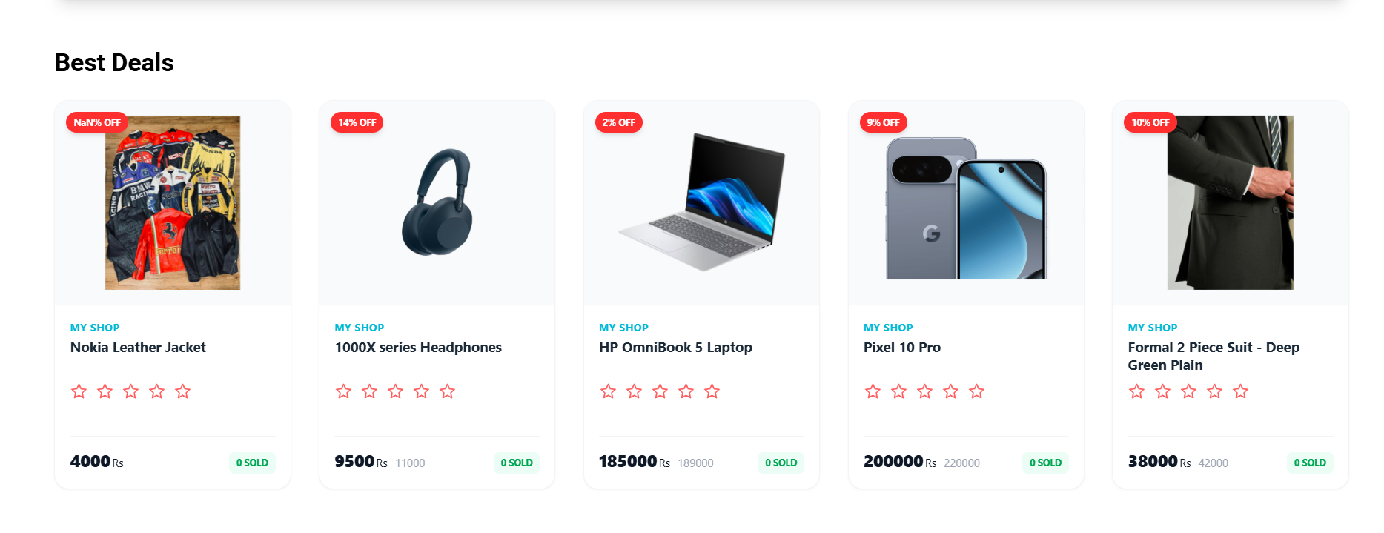
HomePage Best Deal Section

Slide 17
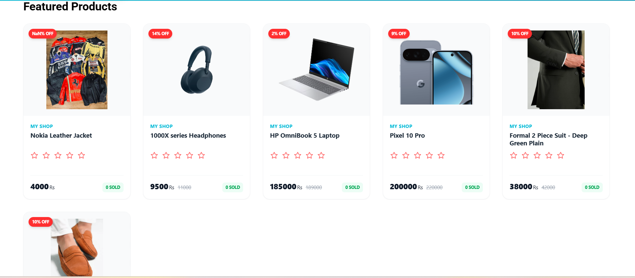
HomePage Feature Product Section

Slide 18
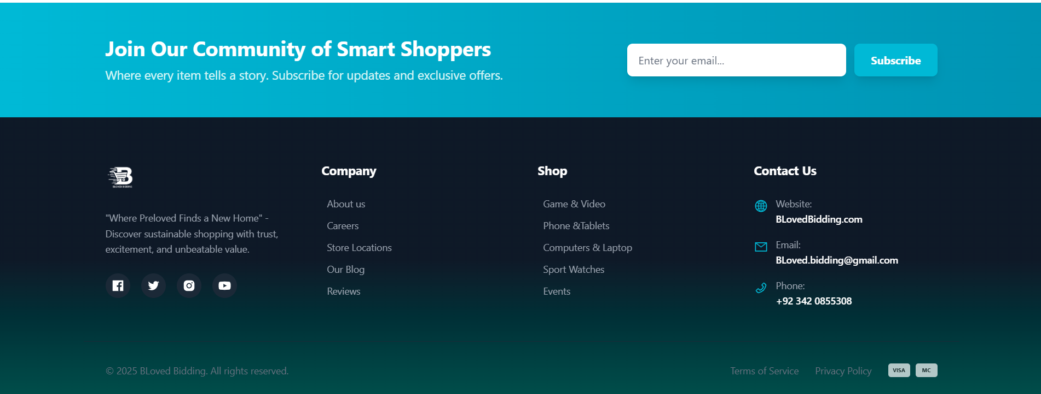
Home Page Footer Section

Slide 19
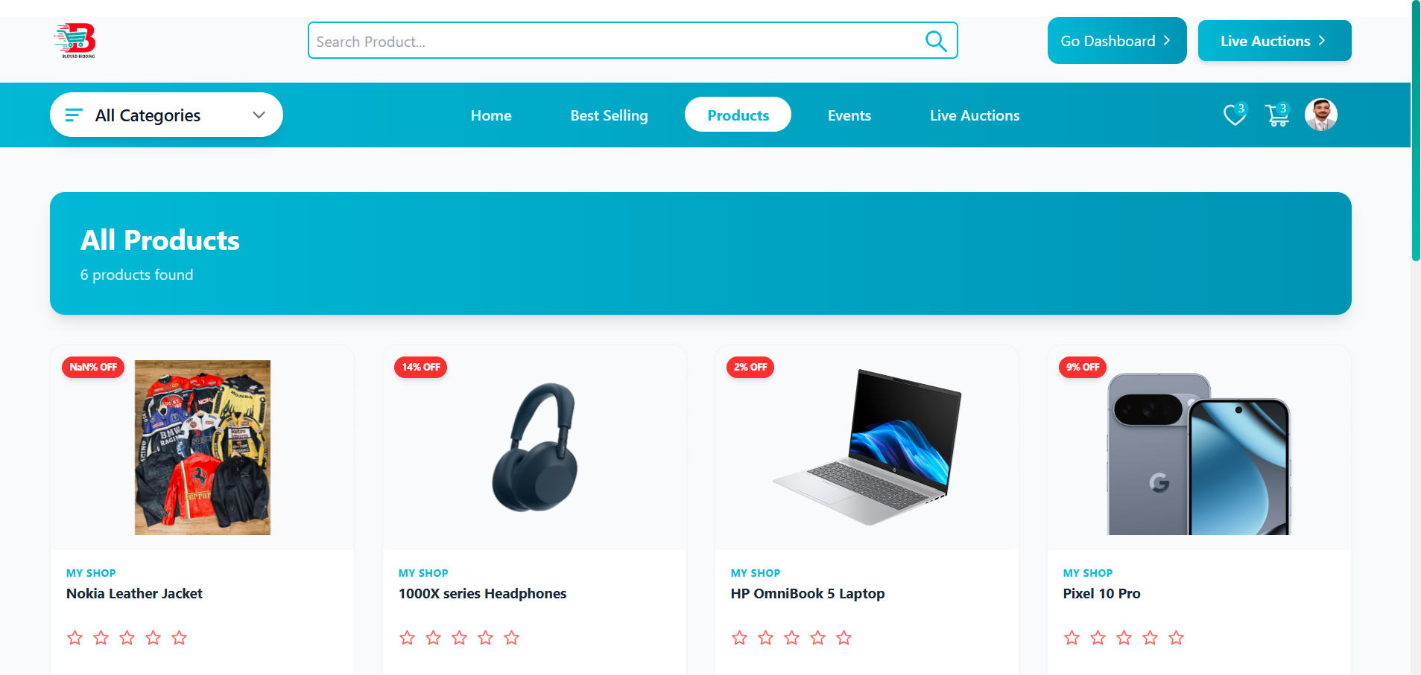
Home Page Products

Slide 20
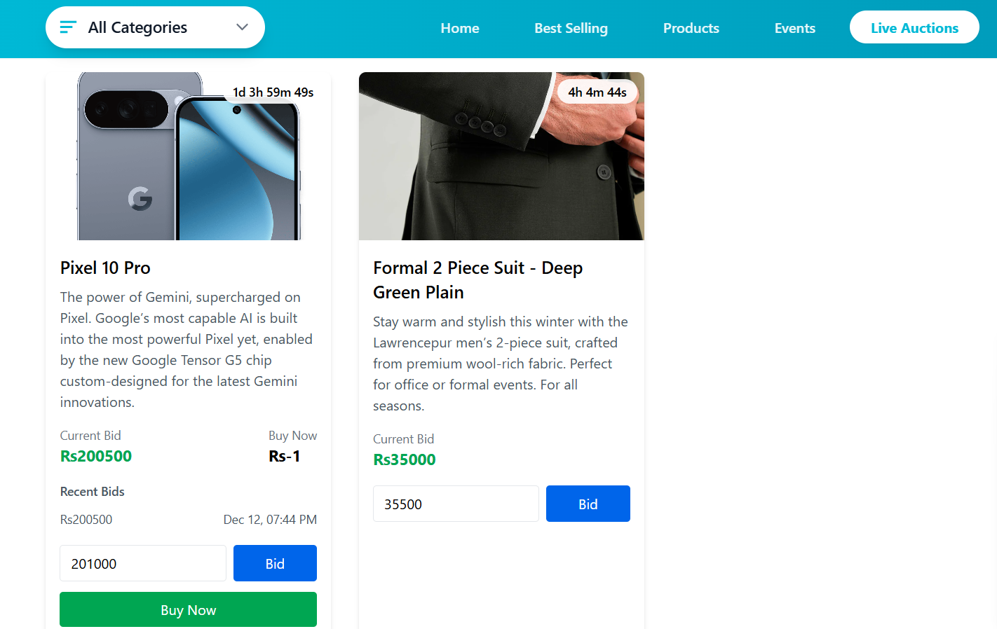
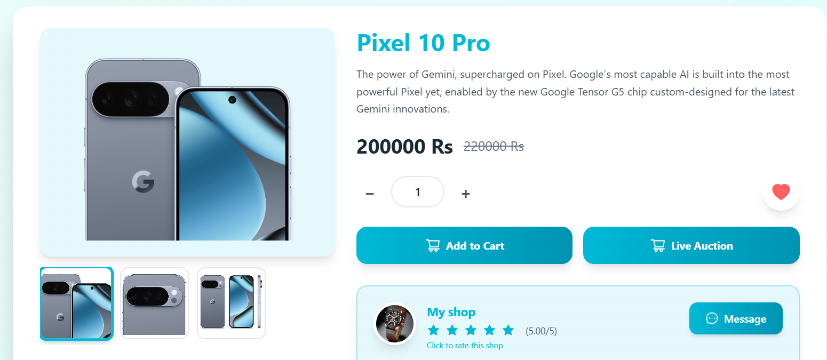
Live Auction

Slide 21
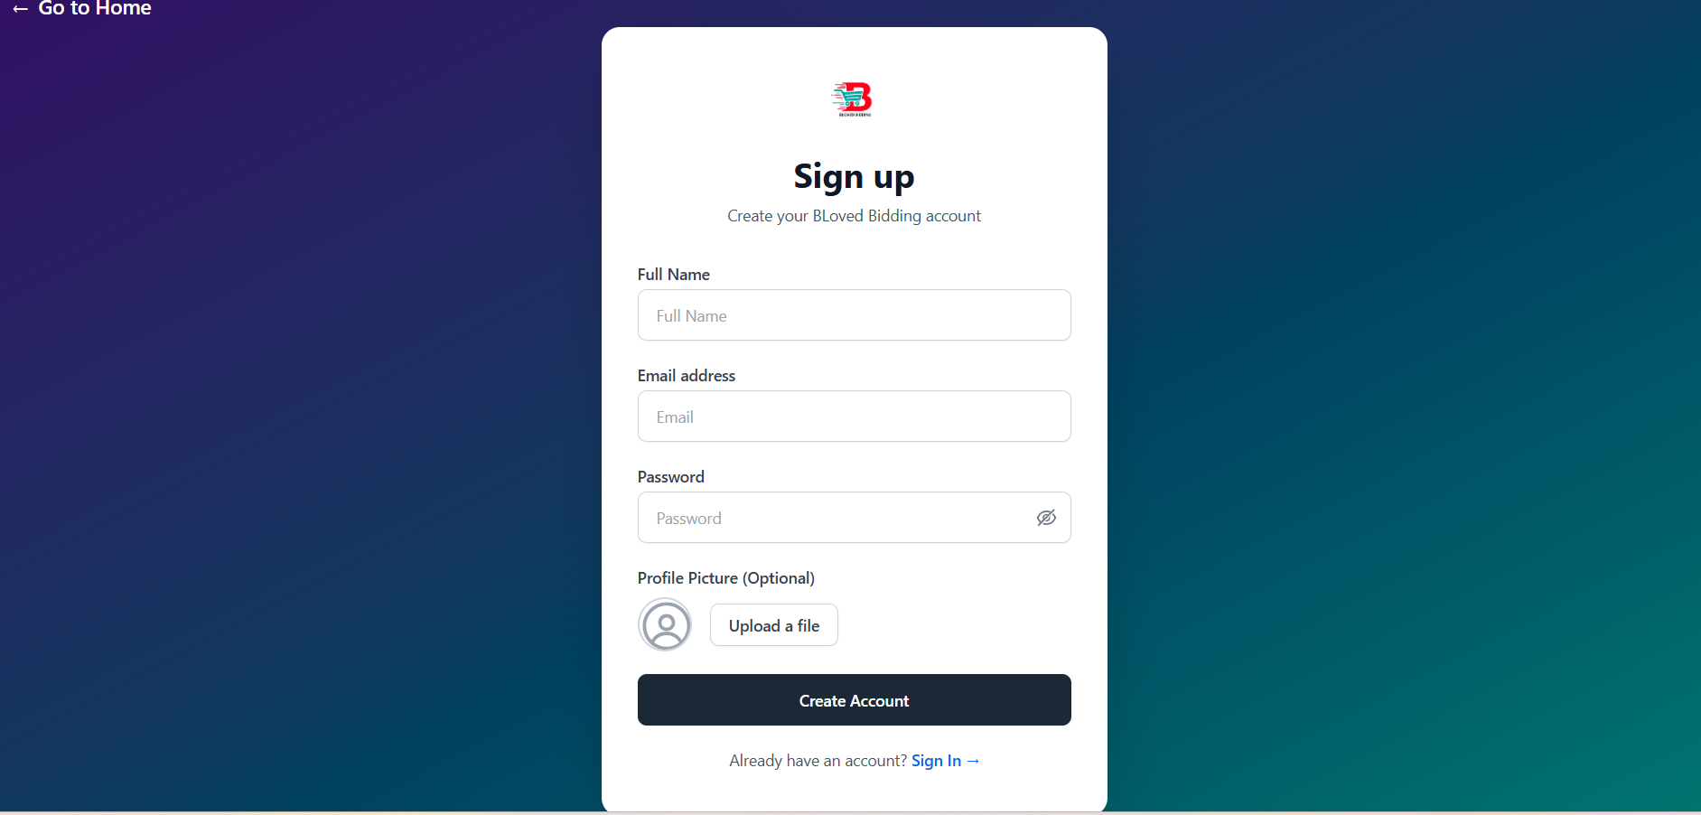
User Sign Up

Slide 22
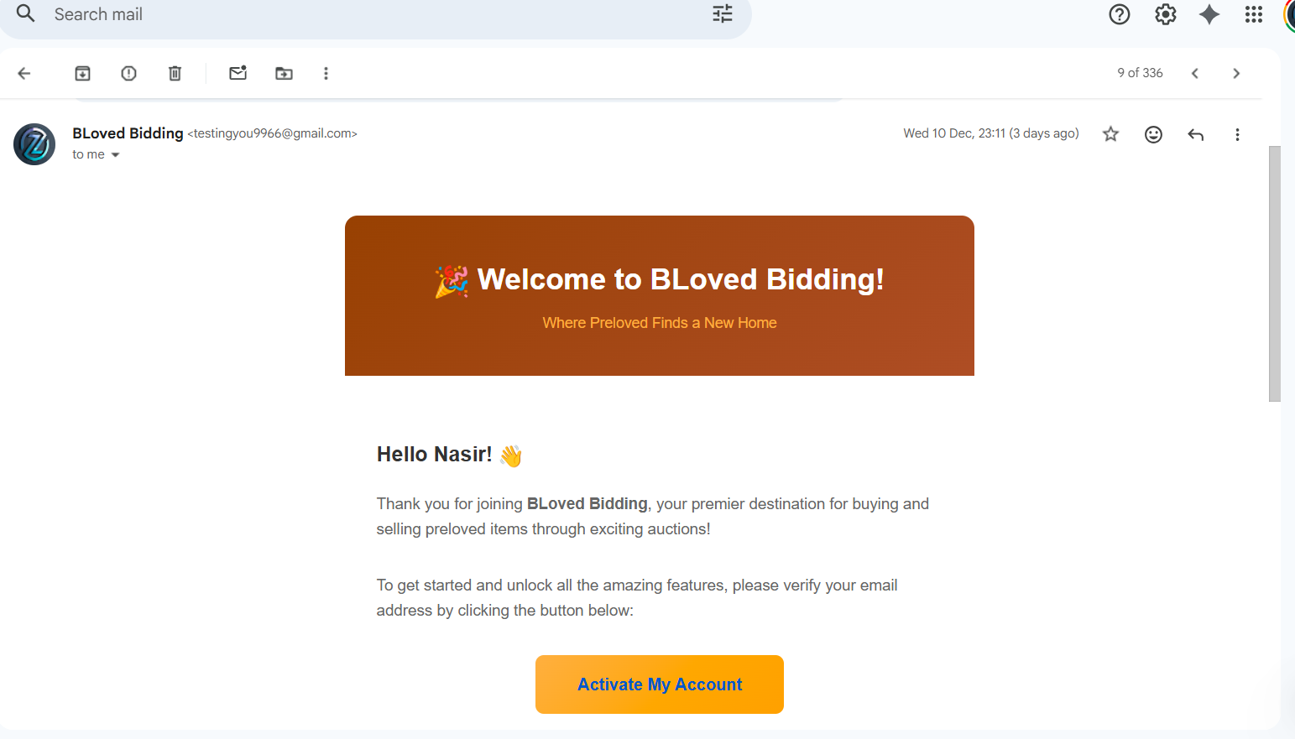
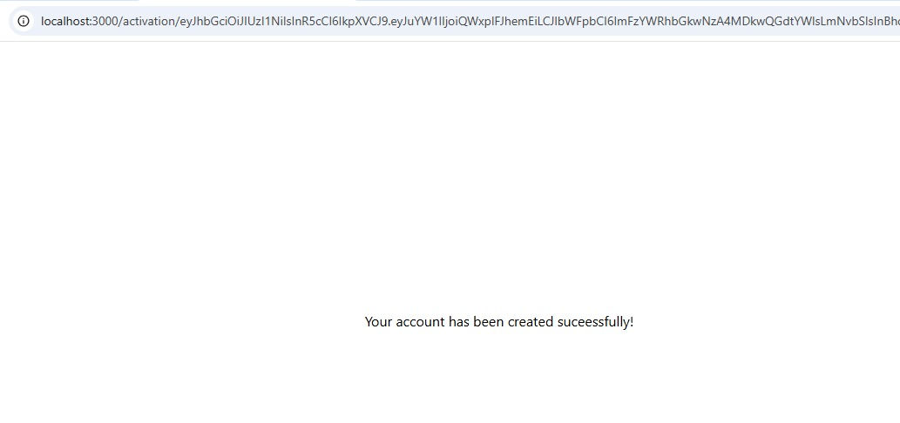
User Sign Up Successfully

Slide 23
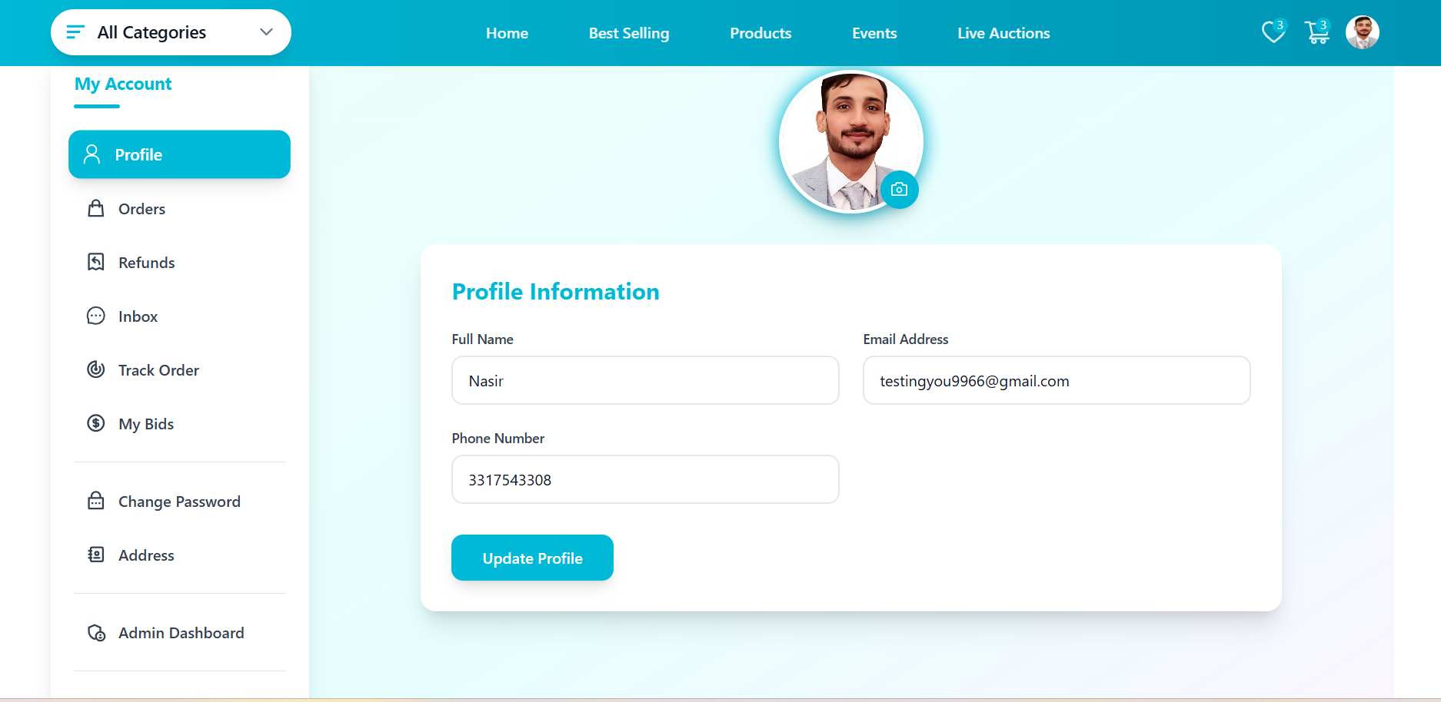
User Profile

Slide 24
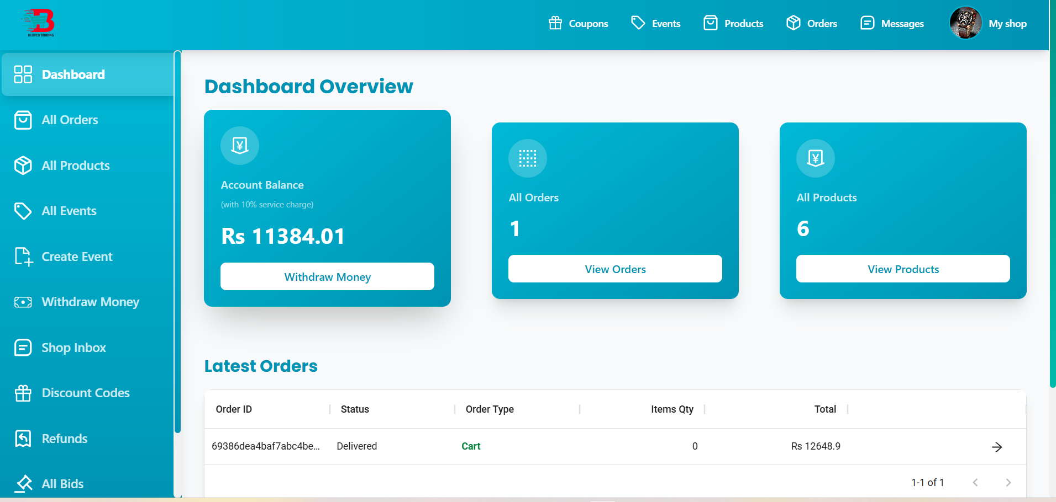
Login Shop

Slide 25
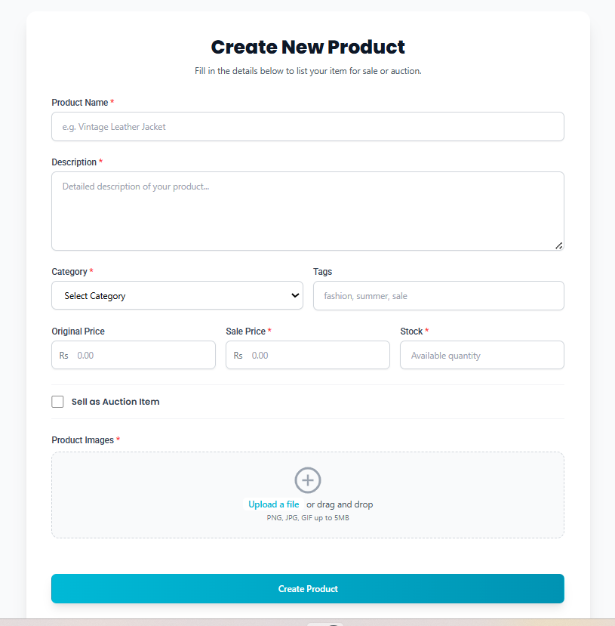
Upload Product With Auction

Slide 26
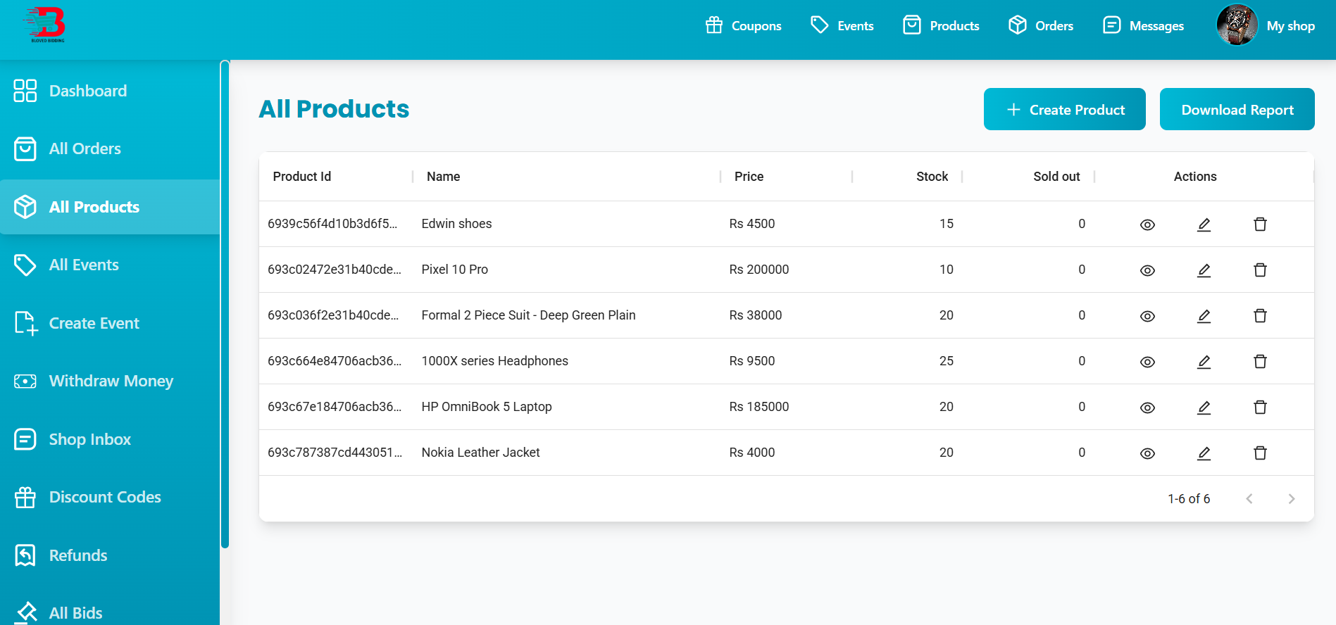
Upload Product

Slide 27
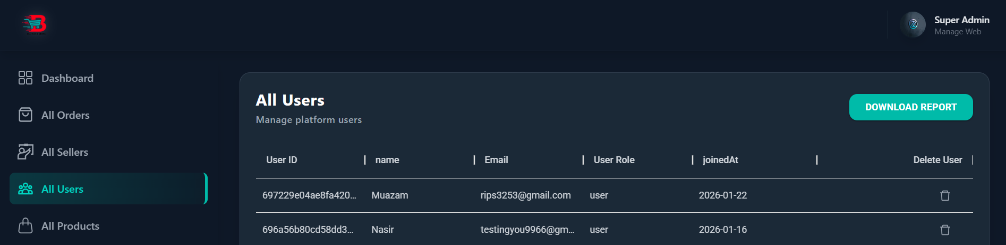
Admin View and Manage User

Slide 28
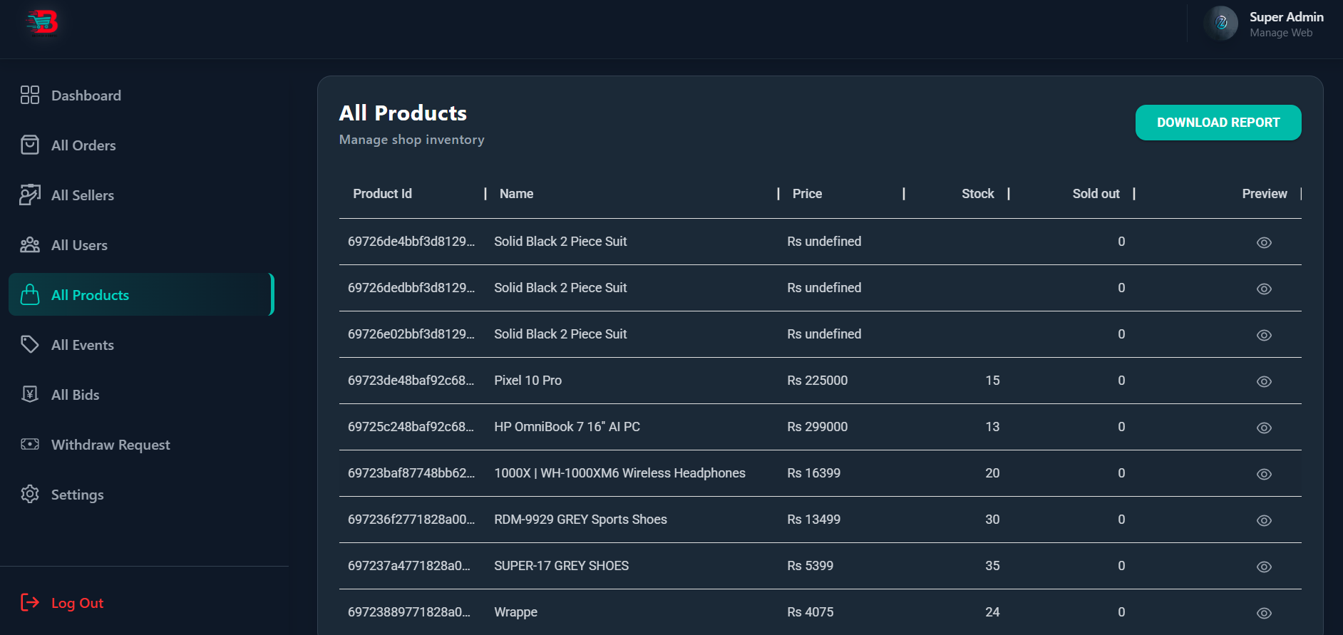
Admin View All Product

Slide 29
Thanks

